Slide 1


CLIMATE SMART CITIES ASSESSMENT FRAMEWORK 2.0
COURSE CODE: SH 101 URBAN MORPHOLOGY
STUDIO
M. ARCH. in SUSTAINABLE HABITAT
SEMESTER 1 A.Y. 2022-23
BY: Gautam Parwar
INDICATORWISE ASSESSMENT

Slide 2
Energy & Green Buildings | Urban Planning, Green Cover, & Biodiversity | Mobility and Air Quality | Water Management | Waste Management
1. Electricity Consumption in the City | 1. Rejuvenation & Conservation of Water Bodies & Open Areas | 1. Clean Technologies Shared Vehicles | 1. Water Resources Management | 1. Waste minimization initiatives undertaken by the City
2. Total Electrical Energy in the City Derived from Renewable Sources | 2. Proportion of Green Cover | 2. Availability of Public Transport | 2. Extent of Non-Revenue Water | 2. Extent of dry waste recovered & recycled
3. Fossil Fuel Consumption in the City | 3. Urban Biodiversity | 3. Percentage of coverage of NMT network (pedestrian & bicycle) in the city | 3. Wastewater Recycle and Reuse | 3. Construction & Demolition (C&D) waste management
4. Energy efficient street lighting in the city | 4. Disaster Resilience | 4. Level of Air Pollution | 4. Flood/ water stagnation risk management | 4. Extent of Wet Waste Processed
5. Promotion of green buildings | 5. City Climate Action Plan | 5. Clean Air Action Plan (Planning and Implementation) | 5. Energy efficient water supply system | 5. Scientific Landfill availability & operations
6. Green Building Adoption |  |  | 6. Energy efficient wastewater management system | 6. Landfill/ dumpsite Scientific Remediation
M. ARCH. in SUSTAINABLE HABITAT

Slide 3
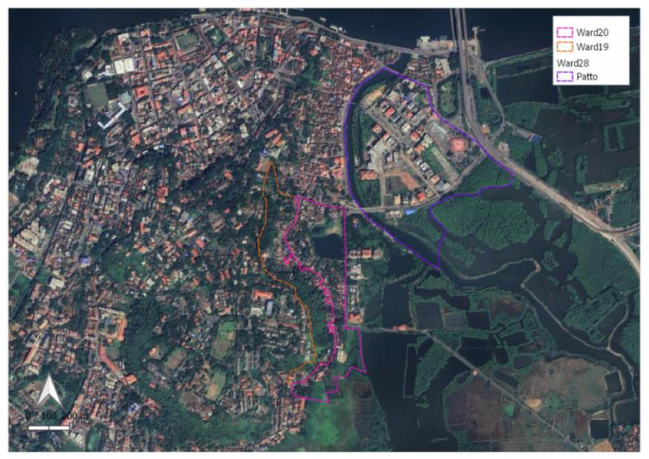
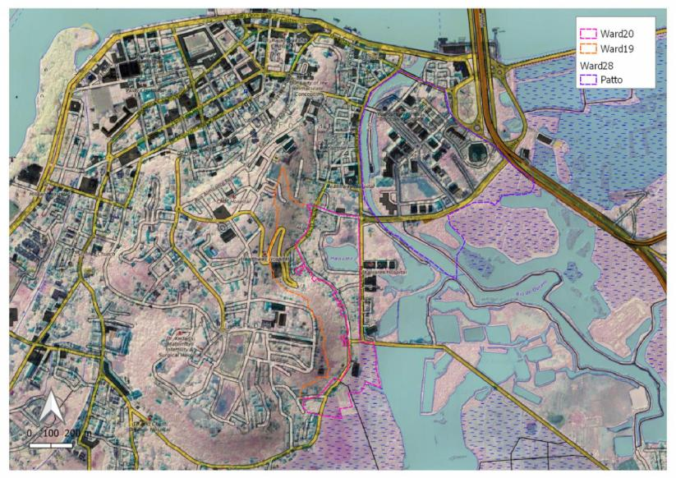
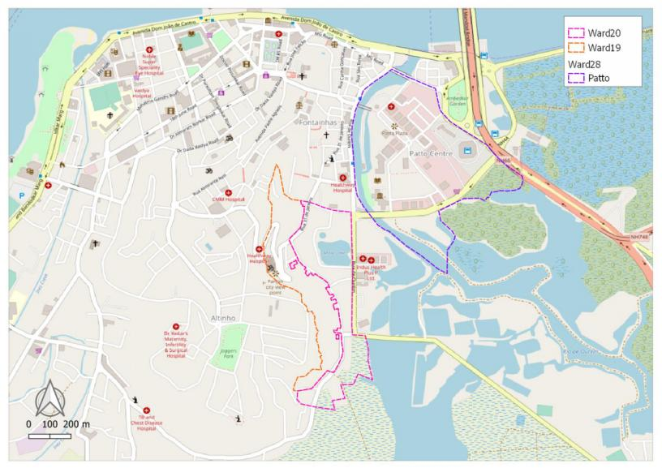
STUDY AREA WARD 19, 20 & 28 (PATTO), PANAJI, GOA, INDIA.
M. ARCH. in SUSTAINABLE HABITAT

Slide 4
STATISTICS WARD 19, 20 & 28 (PATTO), PANAJI, GOA, INDIA.
Particulars | Ward 19 | Ward 20 | Ward 28(Patto) | Panaji (CCP)
Historically Establised | 1784 | 1784 | 1983 | 1759
Area | 1,32,292 sq.m. | 1,64,825 sq.m. | 4,17,322 sq.m. | 81,20,000 sq.m.
Population | 2150 | 1360 | 1223 (inc. Ribander) | 1,00,012
Households | 513 | 309 | 296 (inc. Ribander) | 10,158
Floating Population | - | - | - | 7578 per Day
Tourist Population | - | - | - | 9642 per Day
Water Connections | 100% | 100% | 100% | 100%
Water Supply Hours | 4 | 4 | 5 | 1-7
Community Toilets | 1 | 2 | 1 | 11
STP | 0 | 0 | 1 | 2
Solid Waster Zone | 5(part) | 5(part) | 9 | -
Sample yearly power consumtion | 2496 units per building | - | 14,952 units per building(Patto only) | 2030 KWHr per customer avg.
Source: Pananji CDP, CSM Plan, Census & Survey.
M. ARCH. in SUSTAINABLE HABITAT

Slide 5
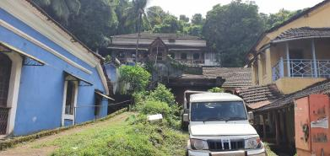
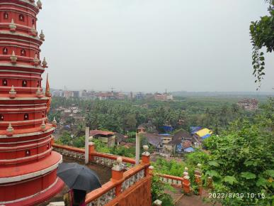
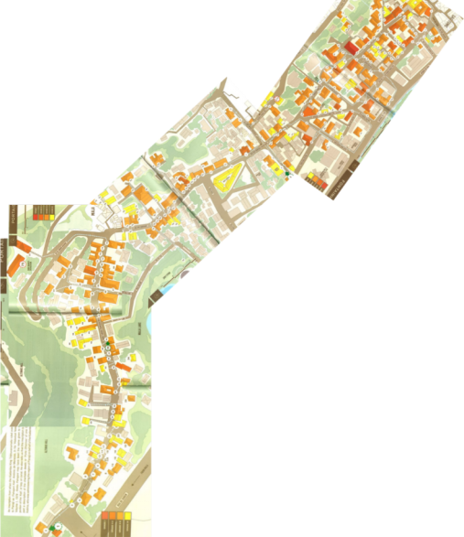
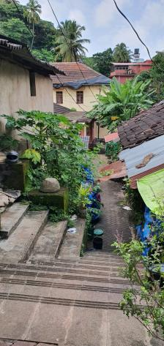
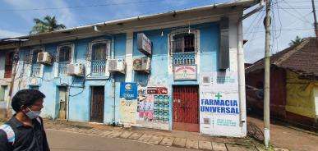


PROFILE WARD 19
M. ARCH. in SUSTAINABLE HABITAT
PIC CREDIT WINTI RODRIGUES

Slide 6

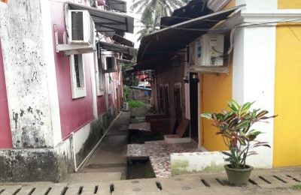

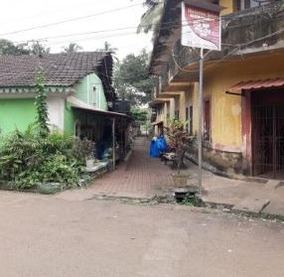
PROFILE WARD 20
M. ARCH. in SUSTAINABLE HABITAT
PIC CREDIT WINTI RODRIGUES

Slide 7
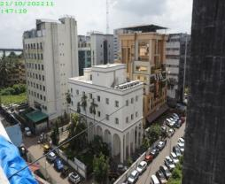
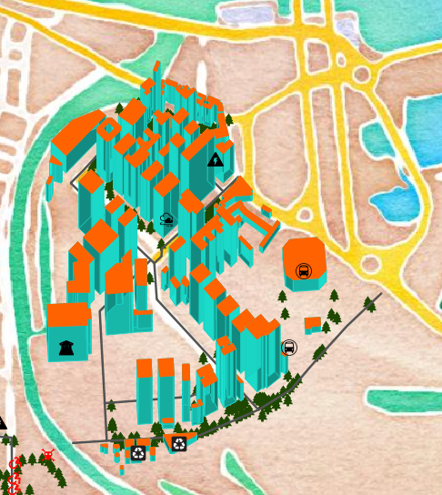
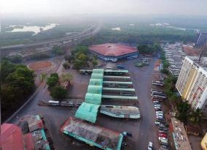
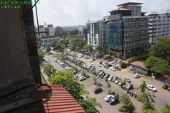
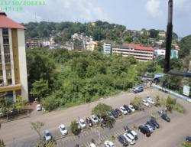
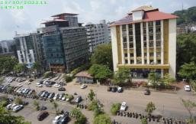
PROFILE WARD 28 (PATTO)
M. ARCH. in SUSTAINABLE HABITAT

Slide 8
ENERGY & GREEN BUILDINGS
Energy & Green Buildings
1. Electricity Consumption in the City
2. Total Electrical Energy in the City Derived from Renewable Sources
3. Fossil Fuel Consumption in the City
4. Energy efficient street lighting in the city
5. Promotion of green buildings
100
100
100
100
100
1
5
M. ARCH. in SUSTAINABLE HABITAT
2
4
3
SCORE WEIGHTAGE

Slide 9

Energy & Green Buildings
1. Electricity Consumption in the City
Rationale
Growing urban areas and urban population increase electricity consumption in cities. Electricity generation is primarily dependent on fossil fuels, leading to higher GHG emissions. Controlling the per capita consumption of electricity will lead to lower GHG emissions.
Description
The indicator assesses the amount of electricity that is used by the city and encourages lower consumption in comparison to the best performing cities.
Methodology
Total electricity consumption (kWh) in the city is calculated. The population data of city is used for per capita calculations.
(Unit: kWh per capita)
M. ARCH. in SUSTAINABLE HABITAT
Total electricity consumption (in kWh) in the city for the assessment year
Formula =
Population of the city

Slide 10
Energy & Green Buildings
1. Electricity Consumption in the City
Evaluation Score Levels
0
25
50
75
100
Level 5
Level 4
Level 3
Level 2
Level 1
M. ARCH. in SUSTAINABLE HABITAT
Up to 1.1X as
compared to the
city with the
lowest electricity
consumption
per capita
> 1.1 X & < 2X as
compared to the
city with the
lowest electricity
consumption per
capita
> 2X & < 4X as
compared to the
city with the
lowest electricity
consumption per
capita
> 4X & < 10X as
compared to the
city with the
lowest electricity
consumption per
capita
> 10X compared
to the city with
lowest electricity
consumption per
capita

Slide 11
Energy & Green Buildings
1. Electricity Consumption in the City
Evidence Requirements
Total electricity consumption of the city from DISCOMs
Census of India population figures indexed with average annual growth rate for the year 2019
Data Evidence Available
Type | Value | Unit | Source
Total electricity consumption of the city from DISCOMs | 12x3050980 | KWhr | Electricity Dept, Panaji
Census of India population figures indexed with average annual growth rate for the year 2019 | 4733 | Persons | Solar City Master Plan, Corporation of City of Panaji
M. ARCH. in SUSTAINABLE HABITAT

Slide 12
Energy & Green Buildings
1. Electricity Consumption in the City
Calculation
Result
Per capita consumption of electricity in ward 19, 20, 28 of Panaji is 23.3 times more than that of Bihar which has lowest per capita electricity consumption of 332 KWPhPc
Current Progression Level : 1
Score | 0
36611760
Value =
= 7735.42 KWhPc
4733
(Unit: kWh per capita)
M. ARCH. in SUSTAINABLE HABITAT
> 10X compared
to the city with
lowest electricity
consumption per
capita
1
2
3
4
5
> 4X & < 10X
> 2X & < 4X
> 1.1 X & < 2X
Up to 1.1X

Slide 13
Energy & Green Buildings
1. Electricity Consumption in the City
Indicator Analysis
Indicator does not take into account large number of floating population in Ward 28(Patto) which uses high amount of electricity in their offices, it does not mention time period of data
Indicator encourages resident population to diversify energy usage and increase efficiency.
Electricity supply zone can share power with area beyond city limits. Grid network not necessarily follows administrative boundaries.
Possible Scenarios
Energy in the form of streetlights, inverters etc is gets wasted at night when offices are closed at Patto
Lobbies of the buildings are lit up at night for security reasons
Other safety equipment like Camera, Motion Sensors, Fire Alarms use continuos energy supply
Branding Signs on top of the building or around use power
Parking lot and accent lighting are always lit
Possibly computer servers and other appliances are left on at night
M. ARCH. in SUSTAINABLE HABITAT

Slide 14

Energy & Green Buildings
2. Total Electrical Energy in the City Derived from Renewable Sources
Rationale
Fossil fuels such as coal, natural gas and oil are the major sources of energy generation in our country. Production of energy from cleaner renewable energy sources (solar PV, solar thermal, wind energy, hybrid-hydel power, small hydro, geo-thermal energy, tidal energy, biogas, waste to energy) would minimize GHG emissions.
Description
The indicator encourages the replacement of existing electricity generation from fossil fuels with cleaner renewable energy sources
Methodology
Total electrical energy in the city is calculated by adding 80% of the ratio of total electrical energy consumption from all grid connected renewable energy sources (kWh) to total electricity consumption (in kWh) in the city and 20% of the ratio of installed capacity of off grid renewable energy sources for self-consumption (kW) to total connected load (kW) in the city
M. ARCH. in SUSTAINABLE HABITAT

Slide 15
Energy & Green Buildings
2. Total Electrical Energy in the City Derived from Renewable Sources
Evaluation Score Levels
0
25
50
75
100
Level 5
Level 4
Level 3
Level 2
Level 1
M. ARCH. in SUSTAINABLE HABITAT
Renewable
Energy
contribution of
> 15%
Renewable
Energy
contribution of
10-15%
Renewable
Energy
contribution of
5- 10%
Renewable
Energy
contribution of
less than 5%
No electrical energy
generated from
renewable sources

Slide 16
Energy & Green Buildings
2. Total Electrical Energy in the City Derived from Renewable Sources
Evidence Requirements
Data on total electricity consumption and connected electrical load can be obtained from DISCOMs
Data of installed capacity of all off-grid renewable energy sources used for self-consumption
Data Evidence Available
Type | Value | Unit | Source
Total electrical energy consumption (in kWh) from all on-grid renewable energy sources | 86390 | KWhr | Electricity Dept, Panaji
Total Electricity Consumption of the area | 36611760 | Kwhr | Electricity Dept, Panaji
M. ARCH. in SUSTAINABLE HABITAT

Slide 17
Energy & Green Buildings
2. Total Electrical Energy in the City Derived from Renewable Sources
Total electricity consumption from all renewable sources of the area | 158004 | KW | Electricity Dept, Panaji
Total connected electrical load in the area | 709386.5 | KW | Electricity Dept, Panaji
(Unit: %)
M. ARCH. in SUSTAINABLE HABITAT
Total electrical energy consumption (in kWh) from all on-grid renewable energy sources
Formula = [ 0.8 x ]
+
[ 0.2 x ]
x
100
Total electricity consumption (in kWh) in the city
Cumulative installed capacity (in KW) of off grid renewable energy sources
Total connected electrical load (in KW) in the city

Slide 18
Energy & Green Buildings
2. Total Electrical Energy in the City Derived from Renewable Sources
Calculation
100 x {[0.8 x (86390/36611760)] + 0.2 x [(158004-86390) / 709386.5]} = 2.20 %
Result
Total Electrical Energy in the City Derived from Renewable Sources is 2.20%
Current Progression Level : 2
Score | 25
(Unit: %)
M. ARCH. in SUSTAINABLE HABITAT
Renewable
Energy
contribution of
less than 5%
1
2
3
4
5
5- 10%
10-15%
> 15%

Slide 19
Energy & Green Buildings
2. Total Electrical Energy in the City Derived from Renewable Sources
Indicator Analysis
Low amount of Renewable Energy generated in the city
City has plan in place to incentivize for on-grid solar power generation
4.7 Rs per unit of generation of power( Source: Goa Electricity dept)
CPWD signed MOU with Solar Energy Corporation of India to PV panels on Govt buildings maintained by CPWD
Possible Scenarios
Cheaper Grid energy alternative
Non establishment of renewable energy infra-structure
Initial Cost of installation is high
Efficiency of solar system varying according to weather
Cost of Li-Ion batteries is high
It needs large area
Wind energy is not explored
M. ARCH. in SUSTAINABLE HABITAT

Slide 20



















Energy & Green Buildings
3. Fossil Fuel Consumption in the City
Rationale
Indicator aims to incentivize cities to lower their CO2 emission per capita per area by encouraging them to switch to alternative cleaner fuel sources
Description
The indicator will assess the amount of fossil fuels (kL) i.e. Petrol, Diesel, CNG, LPG, PNG, utilized in the city.
Methodology
Total consumption of Diesel, Petrol, CNG, LPG and PNG are calculated in the city. The consumption of fossil fuel is converted to CO2 emission using respective emission factors. Population of the city is used to assess per capita figures.
(Unit: Tons CO2
equivalent per capita)
M. ARCH. in SUSTAINABLE HABITAT
Total CO2e of fossil fuel consumption (diesel+petrol+LPG+CNG+PNG) by the city
Formula =
Population of the city
(Where, total TCO2e = Total diesel consumption (kL) x 2.62694
+ Total petrol consumption (kL) X 2.20307 + Total LPG Consumption (kL) X 1.51906
+ Total CNG Consumption (kL) X 0.48066 + Total PNG Consumption (kL) X 0.48066)

Slide 21
Energy & Green Buildings
3. Fossil Fuel Consumption in the City
Evaluation Score Levels
0
25
50
75
100
Level 5
Level 4
Level 3
Level 2
Level 1
M. ARCH. in SUSTAINABLE HABITAT
Up to 1.1X as
compared to the
city with the
lowest electricity
consumption
per capita
> 1.1 X & < 2X as
compared to the
city with the
lowest electricity
consumption per
capita
> 2X & < 4X as
compared to the
city with the
lowest electricity
consumption per
capita
> 4X & < 10X as
compared to the
city with the
lowest electricity
consumption per
capita
> 10X compared
to the city with
lowest electricity
consumption per
capita

Slide 22
Energy & Green Buildings
3. Fossil Fuel Consumption in the City
Evidence Requirements
The data on the consumption of petroleum products
Census of India population figures indexed with average annual growth rate for the year 2019
Data Evidence Available (City Level)
Type | Value | Unit | Source
Consumption of Petrol | 18038 | KL | Solar City Master Plan, Corporation of City of Panaji
Consumption of Diesel | 16122 | KL | Solar City Master Plan, Corporation of City of Panaji
Consumption of LPG | 1246 | KL | Solar City Master Plan, Corporation of City of Panaji
Consumption of CNG | 806 | KL | Heera Petroleum, Panaji
Consumption of PNG | 0 | KL | -
M. ARCH. in SUSTAINABLE HABITAT

Slide 23
Energy & Green Buildings
3. Fossil Fuel Consumption in the City
Data Evidence Available (Ward Level)
Source Agency | Petrol Sales | Diesel Sales | CNG Sales | LPG Sales | PNG Sales
Hindustan Petroleum | 5500 L/D | 800 L/D | 0 | 0
Bharat Petroleum | 9000 L/D | 5000 L/D | 0 | 0
Heera Petroleum, Indian Oil | 16000 L/D | 15000 L/D | 1600 KG/D | 0
Goa Natural Gas Pvt Ltd |  | 0 | 0 |  | 8050000 (State level)
PNG Rate in Goa is Rs.25/ SCM (Source: Goa Natural Gas Pvt. Ltd.)
Source: Petroleum Product Retailers in the area, Annual Report 2022-Goa Natural Gas Pvt. Ltd.
M. ARCH. in SUSTAINABLE HABITAT

Slide 24
Energy & Green Buildings
3. Fossil Fuel Consumption in the City
Calculation
Result
Total CO2 emission per capita in the area is 1.032 Tons Co2 Equivalent per Capita, which is lower than national Per capita fossil fuel consumption is 1.61 Tons CO2 equivalent per capita. (Source: World Bamk)
Current Progression Level : 5
Score: | 100
84370.6640
Value =
= 1.036 Tons Co2ePC
81368
(Unit: Tons CO2
equivalent per capita)
M. ARCH. in SUSTAINABLE HABITAT
Uptio 1.1X compared
to the city with
lowest Co2e per
capita
1
2
3
4
5
>10X
> 4X & < 10X
> 2X & < 4X
> 1.1 X & < 2X

Slide 25
Energy & Green Buildings
3. Fossil Fuel Consumption in the City
Indicator Analysis
It is not clear fuel consumption to be considered for which time scale
Low per capita fossil fuel consumption in the area
Fuel may not be filled within city limits
High amount of intercity travels
City has floating population of 7141 (2019 projection)
Possible Scenarios
There is absense of Industrial Zone in the city
Intercity car owners fill fuel outside the city limits
Congestion at fuel pumps is deterrent
Municipal Corporation area have different rate of taxes on fuel
36611760
Value =
= 7735.42 KWhPc
4733
M. ARCH. in SUSTAINABLE HABITAT

Slide 26







Energy & Green Buildings
4. Energy efficient street lighting in the city
Rationale
Street lighting is a major contributor to the city’s electricity consumption. Energy efficient and renewable energy operated street lighting systems will reduce the dependence on electricity from fossil fuels thus indirectly reduce GHG emissions in the city.
Description
The indicator will assess the extent to which cities have adopted use of energy efficient and renewable energy operated streetlights. Energy efficient streetlights should have lamps with luminous efficacy of more than 85 lumens per watt.
Methodology
Ratio is calculated for the total number of energy efficient and renewable energy operated streetlights in the city to total number of streetlights in the city.
(Unit: %)
M. ARCH. in SUSTAINABLE HABITAT
Total number of energy efficient street lights + renewable energy operated street lights in the city
Formula = 100 x
Total number of street lights in the city

Slide 27
Energy & Green Buildings
4. Energy efficient street lighting in the city
Evaluation Score Levels
0
25
50
75
100
Level 5
Level 4
Level 3
Level 2
Level 1
M. ARCH. in SUSTAINABLE HABITAT
All streets lights
in the city are
energy efficient
or renewable
energy operated
Up to 75% streets lights in the city are
energy efficient or renewable energy operated
Up to 50% streets lights in the city are
energy efficient or renewable energy operated
Up to 25%
streets lights
in the city are
energy efficient or renewable energy operated
No streetlights in the city is energy efficient

Slide 28
Energy & Green Buildings
4. Energy efficient street lighting in the city
Evidence Requirements
Municipal records/documentary evidence for the number of streetlights with energy efficient lamps
Municipal records/documentary evidence for the number of streetlights operated with renewable energy
Map of all streetlights in the city as .kml files (point geometry with optional attributes for energy efficient lamps)
Data Evidence Available
Type | Value | Unit | Source
Total number of street lights in the city | 3322 | Pc | Electricity Dept, Panaji
Total number of street lights in the city converted to LED | 2544 | Pc | Electricity Dept, Panaji
M. ARCH. in SUSTAINABLE HABITAT

Slide 29
Energy & Green Buildings
4. Energy efficient street lighting in the city
Calculation
Result
76.58 percent of total streetlights in the city have energy efficient LED fixtures.
Current Progression Level : 4
Score: | 75
2544
Value = 100 x
= 76.58 %
3322
(Unit: %)
M. ARCH. in SUSTAINABLE HABITAT
Up to 75% streets lights in the city are
energy efficient or renewable energy operated
1
2
3
4
5
0%
Upto 25%
Upto 50%
100%

Slide 30
Energy & Green Buildings
4. Energy efficient street lighting in the city
Indicator Analysis
More than two thirds of street lights in the city have LED fixtures
Score terminology needs to change from ‘Upto’ to ‘More Than or Equal to (> =)’
All streetlights are drawing power from the grid network
There are no RE street light fixture working in the city
RE system has been tried and dicontinued
Possible Scenarios
RE system are prone to dependent on weather conditions
Li-Ion batteries are high value and prone to be stealing
Skilled personnels to deal with RE system are not available
Capital & maintenance cost of RE system is high
2544
Value = 100 x
= 76.58 %
3322
M. ARCH. in SUSTAINABLE HABITAT

Slide 31
Energy & Green Buildings
5. Promotion of green buildings
Rationale
Buildings, throughout their life cycles, are one of the prime contributors of GHG emissions in the city. In order to encourage the construction and use of green and energy efficient buildings, national building code 2016 and energy conservation of building codes are developed and notified by the Government. There are number of compliances, implementation procedures and stakeholder co-operation that needs to be in place from the city’s side for effective adoption of green buildings. This indicator checks the readiness of the city regarding the compliance procedures, penalty/reward schemes and stakeholder co-operation for subsequent promotion of new and existing green and energy efficient buildings.
Description
Compliance and implementation procedures for various green building norms at city level requires integration of these provisions in the General Development Control Regulations (GDCRs), building byelaws/rules, formation of green building cells/ equivalent in ULBs etc. Green buildings are defined by established rating systems including Bureau of Energy Efficiency (BEE), Leadership in Energy & Environmental Design (LEED), Excellence in Design for Greater Efficiencies (EDGE), Green Rating for Integrated Habitat Assessment (GRIHA), Indian Green Building Council (IGBC), Green and Eco-friendly Movement (GEM).
Methodology
Compliance procedures are only available at state level. Assessment will be on the basis of inclusion of latest provisions of codes, regulations for green buildings at city level, formation of green building cell within city ULBs, availability of promotional/ penalty schemes to spur demand for green buildings, and formation of city level green building committee/ equivalent for stakeholder co-operation.
(Unit: None)
M. ARCH. in SUSTAINABLE HABITAT

Slide 32
Energy & Green Buildings
5. Promotion of green buildings
Evaluation Score Levels
0
25
50
75
100
Level 5
Level 4
Level 3
Level 2
Level 1
M. ARCH. in SUSTAINABLE HABITAT
All four measures
implemented
Three measures
implemented
Two measures
implemented
One measure
implemented
No measures
implemented

Slide 33
Energy & Green Buildings
5. Promotion of green buildings
Evidence Requirements
MEASURE 1: Inclusion of Part 11 of National Building Code (NBC 2016) and/or Energy Conservation Building Codes (ECBC 2017) for commercial buildings & Eco-Niwas Samhita 2018 for residential buildings and/ or minimum level of green building rating systems notified in City Development Control Regulations (DCRs/GDCRs) and building rules/bye laws
MEASURE 2: Functioning of green building cell in ULB for the purpose of knowledge dissemination, creating public awareness, empaneling green building vendors, designing green building schemes and their promotions, verification and faster approvals for green buildings in the city.
MEASURE 3: Promotional/ Penalty schemes available for code compliance, pre- certification, certification of green buildings.
MEASURE 4: Functioning of high-level Green Building Committee/ equivalent comprising of ULB’s Commissioner and representatives of ULB green building cell, SPV, PMC, UDD, Town Planner, PWD, Green Building Certification agencies, Developers and Building Professional Associations. The committee will provide strategic advice for the promotion and adoption of energy efficient and green buildings in the city.
M. ARCH. in SUSTAINABLE HABITAT
Data Evidence Available
Type | Value | Unit | Source
Measure 1 is implemented | Draft ECBC is noitified | Energy Conservation Building Codes (ECBC 2020) | Draft ECBD Goa 2020 Rules

Slide 34
Energy & Green Buildings
5. Promotion of green buildings
Calculation
Result
Only one out of four measures are implemented and in effect for the city.
Current Progression Level : 2
Score: | 25
Total number of Meaures to be implemented is 4
Total number of Measures implemented is 1
(Unit: None)
M. ARCH. in SUSTAINABLE HABITAT
One measure
implemented
1
2
3
4
5
0 Measures
2 Measures
3 Measures
4 Measures

Slide 35
Energy & Green Buildings
5. Promotion of green buildings
Indicator Analysis
Legislation to promote Green Buidings is notified
Administrative and support setup is not there
Green Building Cell needs to be in place in the ULB level
Promotion/ Penalty scheme needs to be properly advertised
High Level Green Building Committee is required to be set up
Possible Scenarios
Existing buildings are not evaluated for Green Building Certification
Lack of awareness amongst construction consumers
Skilled personnels/expertise is not available
Institutional mechanism is still in infant stage
Total number of Meaures to be implemented is 4
Total number of Measures implemented is 1
M. ARCH. in SUSTAINABLE HABITAT

Slide 36
ENERGY & GREEN BUILDINGS
Energy & Green Buildings
1. Electricity Consumption in the City
2. Total Electrical Energy in the City Derived from Renewable Sources
3. Fossil Fuel Consumption in the City
4. Energy efficient street lighting in the city
5. Promotion of green buildings
0/100
25/100
100/100
75/100
25/100
1
5
M. ARCH. in SUSTAINABLE HABITAT
2
4
3
TOTAL SCORE = 225 / 500

Slide 37
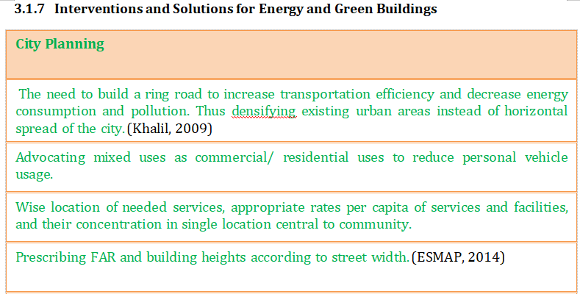
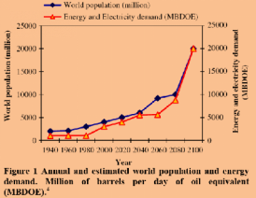
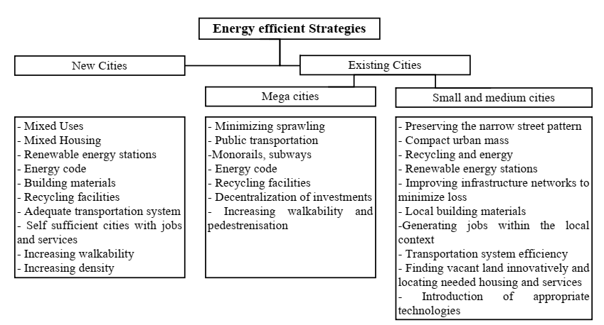
M. ARCH. in SUSTAINABLE HABITAT

Slide 38
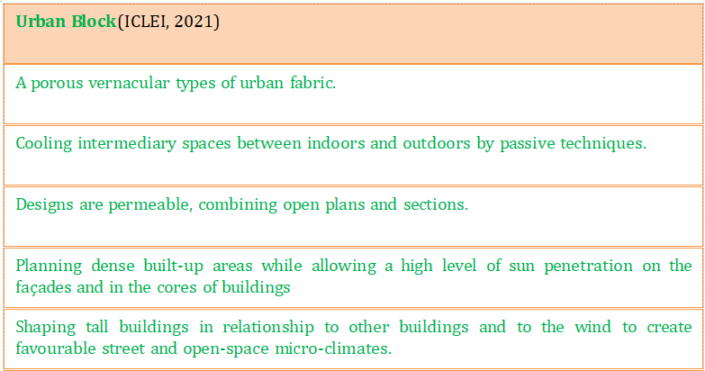
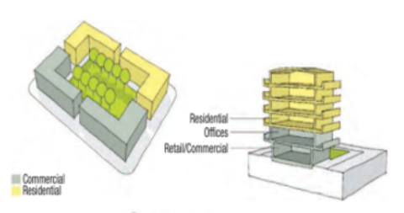
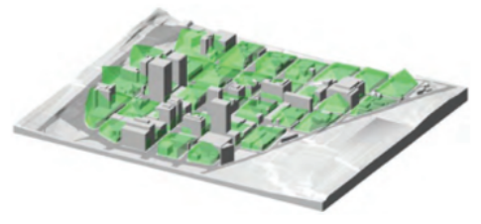
M. ARCH. in SUSTAINABLE HABITAT

Slide 39
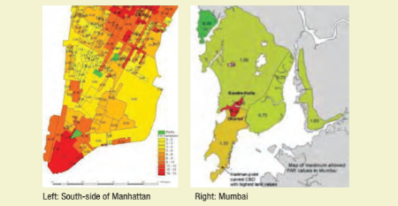
FAR
Prescribing FAR and building heights according to street width
Establish Mixed Use Development
Fine grain texture of plot subdivisions, buildings & building group
Continuous landscaped public space inside and outside the block
Ratio of office, commercial, and residential floors to building scale
M. ARCH. in SUSTAINABLE HABITAT

Slide 40
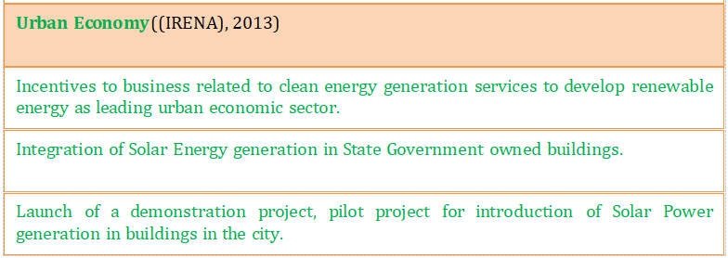
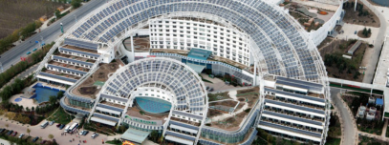
Case Study
CIty of Dezhou, China by IRENA
120 solar energy enterprises which generate an annual turnover of USD 3.46 billion
Encouraging entrepreneuship in products and services used for the generation of solar, wind, hydro, geothermal and bioenergy
City espoused the role of an incubator developing a viable industry cluster and that of multiplier by drawing upon the existing local solar business
 | Solar Valley Micro E Hotel, a landmark of Dezhou, and a solar energy, micro-emission hotel
M. ARCH. in SUSTAINABLE HABITAT

Slide 41
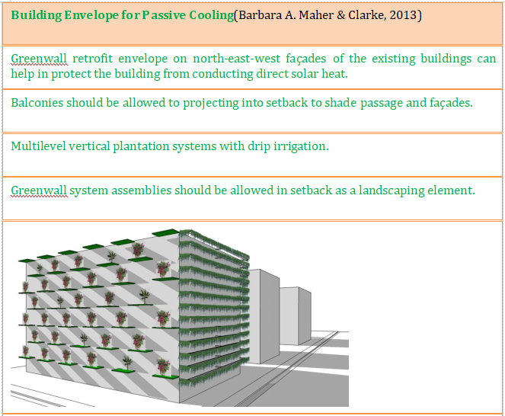
M. ARCH. in SUSTAINABLE HABITAT

Slide 42
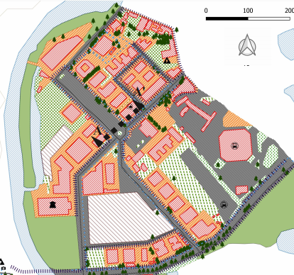
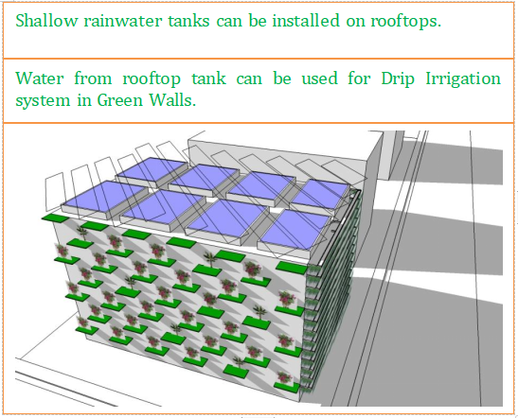
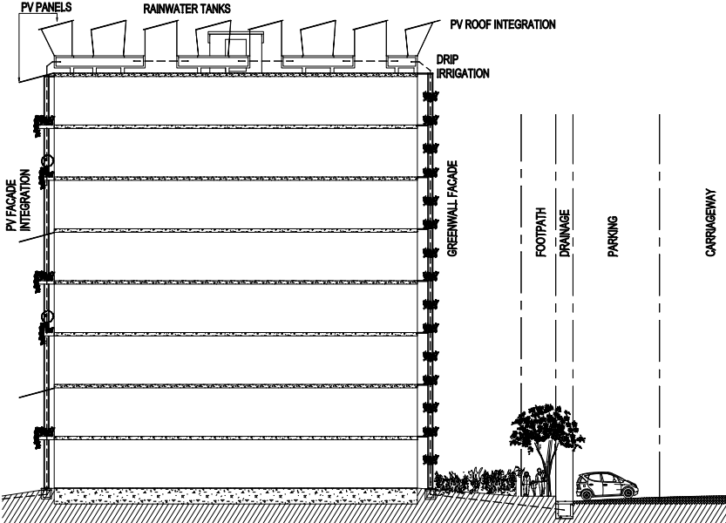
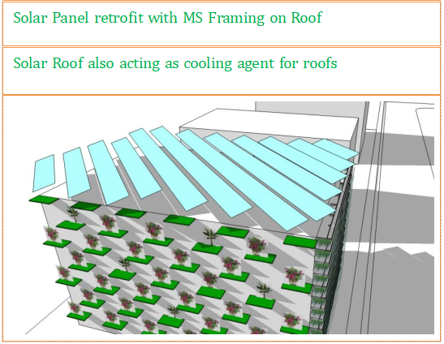
M. ARCH. in SUSTAINABLE HABITAT

Slide 43
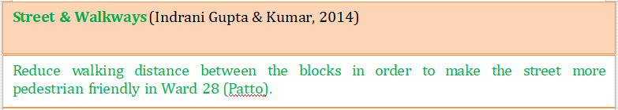
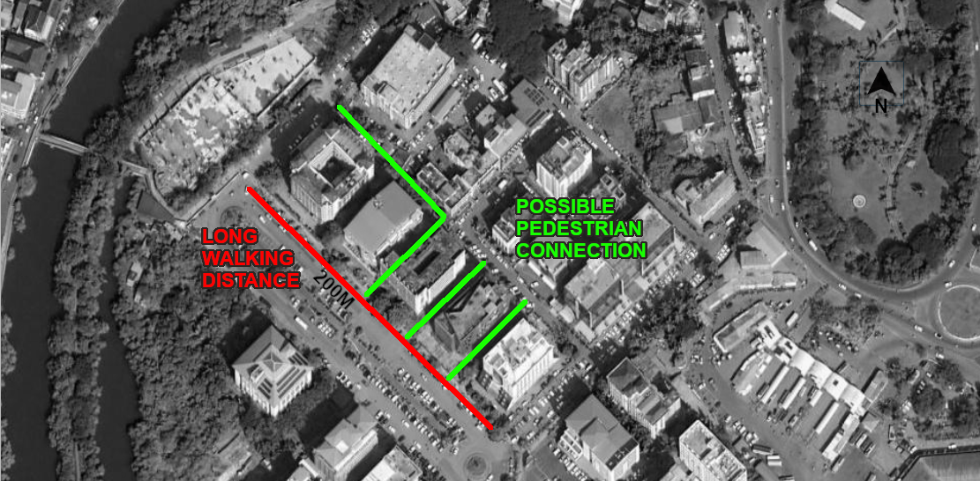
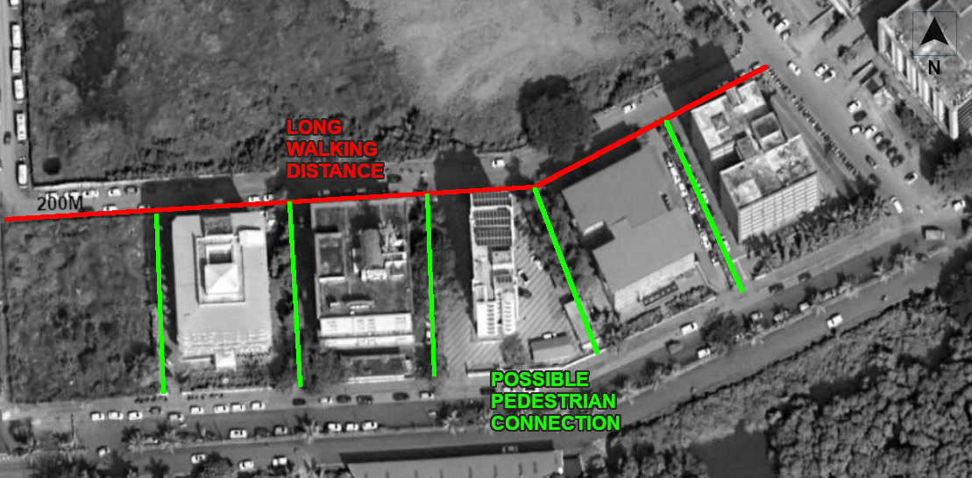
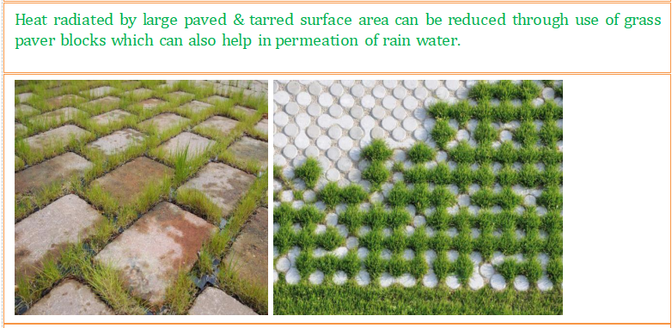
M. ARCH. in SUSTAINABLE HABITAT

Slide 44
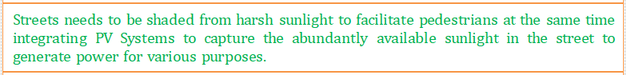
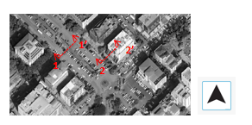
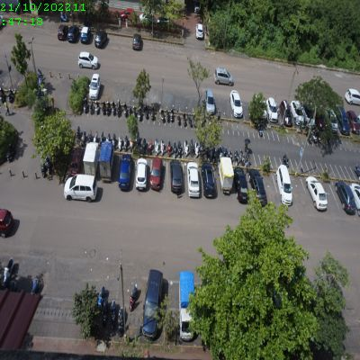
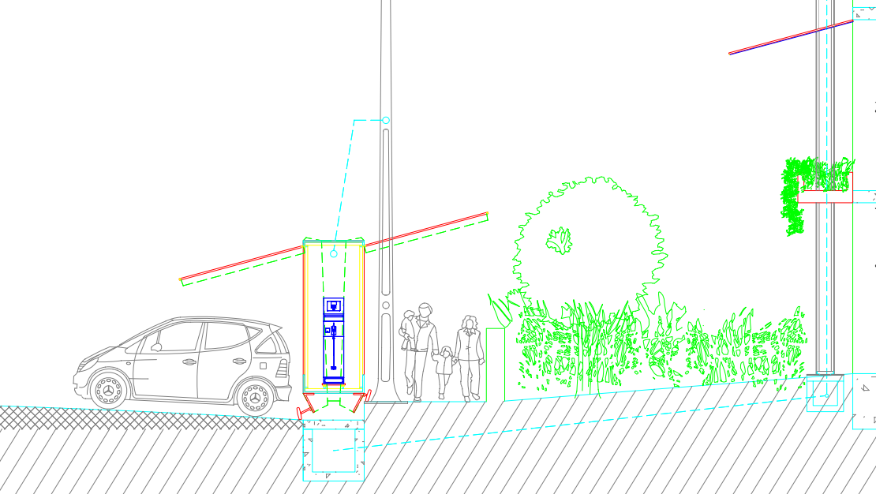
NTS
SECTION 22’
M. ARCH. in SUSTAINABLE HABITAT

Slide 45
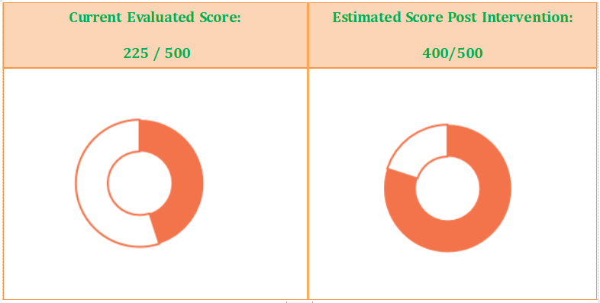
Solar Energy Requirements & Estimates
Total electricity demand in the area is 3,66,117,60 KWHr
Area under PV Panels required to meet the demand is 1,21,070 sq.m.
Area Available (in sq.m.)
Existing Roofs | Upcoming Roofs | Poposed Parking | Southern Facades
45000 | 17000 | 13000 | 10000
Total |  | 85,000 sq.m.
Possible power output from the area |  | 2,57,04,000 KWHr
M. ARCH. in SUSTAINABLE HABITAT

Slide 46
MOBILITY & AIR QUALITY
Mobility and Air Quality
1. Clean Technologies Shared Vehicles
2. Availability of Public Transport
3. Percentage of coverage of NMT network (pedestrian & bicycle) in the city
4. Level of Air Pollution
5. Clean Air Action Plan (Planning and Implementation)
100
100
100
100
100
1
5
M. ARCH. in SUSTAINABLE HABITAT
4
2
3
SCORE WEIGHTAGE

Slide 47
Mobility and Air Quality
1. Clean Technologies Shared Vehicles
Rationale
Conventional fuel burning vehicles release an enormous amount of toxicants to atmosphere, cities must put efforts to introduce a cleaner fuel based shared vehicles.
Description
The indicator assesses the percentage of shared vehicles that operate on clean fuels like CNG, LPG, biofuels or are hybrid or electric vehicles.
Methodology
The city has to calculate the ratio of annual number of clean technologies shared vehicles to total shared vehicles.
(Unit: %)
M. ARCH. in SUSTAINABLE HABITAT
Total number of shared vehicles on clean technologies
Formula = x 100
Total number of shared vehicles in the city

Slide 48
Mobility and Air Quality
1. Clean Technologies Shared Vehicles
Evaluation Score Levels
0
25
50
75
100
Level 5
Level 4
Level 3
Level 2
Level 1
M. ARCH. in SUSTAINABLE HABITAT
Clean technology
shared vehicles
>25%
Clean technology
shared vehicles
15% to <25%
Clean technology
shared vehicles
5% to <15%
Clean technology
shared vehicles
<5%
No clean
technology
shared vehicles
available

Slide 49
Mobility and Air Quality
1. Clean Technologies Shared Vehicles
Evidence Requirements
Registration data from regional transport office by type of fuel
Data Evidence Available (State Level)
Type | Value | Unit | Source
E-Buses | 36 | pc | Imagine Panaji Smart City Ltd
Educational Institution Buses | 189 | pc | Electricity Dept, Panaji
Passenger 3 wheelers | 2,519 | pc | Open Government Data Platform
Maxi cabs | 2,689 | pc | Open Government Data Platform
Motor cabs | 24,795 | pc | Open Government Data Platform
Motor Cycle for hire | 24,055 | pc | Open Government Data Platform
Passenger buses | 5,248 | pc | Open Government Data Platform
Passenger e-Rickshaw | 16 | pc | Open Government Data Platform
Intercity E-Buses | 35 | pc | KTCL
M. ARCH. in SUSTAINABLE HABITAT

Slide 50
Mobility and Air Quality
1. Clean Technologies Shared Vehicles
Calculation
100 x (87/59,582) = 0.15 %
Result
The percentage of shared vehicles that operate on clean fuels is 0.15 %
Current Progression Level : 2
Score | 25
(Unit: %)
M. ARCH. in SUSTAINABLE HABITAT
Clean technology
shared vehicles
<5%
1
2
3
4
5
0%
5- 15%
15-25%
> 25%

Slide 51
Mobility and Air Quality
1. Clean Technologies Shared Vehicles
Indicator Analysis
City has extremely low EV penetration
State has released a comprehensive EV plan but implementation will take time
Easier access to conventional fuel stations
Charging infrastructure is not in place
Shared vechicles are mostly for intercity travel
Possible Scenarios
Lack of institutional setup like City EV poilicy
Lack of infrastructure
Availability of reliable & sufficient electricity is a challenge
Higher capital costs of EVs
Social willingness to accept EVs
Cities lack comparable environmental action plans suitable for EV
City governments may collaborate with private players to co-develop models for EV growth
M. ARCH. in SUSTAINABLE HABITAT

Slide 52
Mobility and Air Quality
2. Availability of Public Transport
Rationale
Under Smart City initiatives, most of the cities are planning for organized public transport system. Increase in extent of supply availability of public transport can be a key factor to evaluate the modal shift from private transport to public transport. In turn helps tremendously to reduce emissions by the transport sector.
Description
The population growth had put forth a tremendous demand for infrastructure and mismatch between demand and supply of transport infrastructure resulted in delays, fuel loss, air and noise pollution, accidents and loss of productive time and energy. Extent of supply availability of public transport is one of the service level performance benchmarks.
Methodology
The city has to calculate the Public Transport Unit (PTU) of total available public transport (which includes fleet size of bus, Metro coach, suburban rail coach and ferries) per 1000 population. Estimated existing population of the city should be considered. Data could either be taken through previous studies, secondary sources or captured through specific primary surveys. Data collected from the primary and secondary sources need to be collated and analyzed.
(Unit: Availability of Public Transport Unit (PTU) per 1000 population)
M. ARCH. in SUSTAINABLE HABITAT
Fleet size of PT (bus+metro coach+suburban rail coach+ferries)
Formula = 1000 x
Estimated existing population of the city

Slide 53
Mobility and Air Quality
2. Availability of Public Transport
Evaluation Score Levels
0
25
50
75
100
Level 5
Level 4
Level 3
Level 2
Level 1
M. ARCH. in SUSTAINABLE HABITAT
Availability of
Public Transport
(≥0.6)
Availability of
Public Transport
(0.4-0.6)
Availability of
Public Transport
(0.2-0.4)
Availability of Public Transport (<0.2)
Public Transport
is not available

Slide 54
Mobility and Air Quality
2. Availability of Public Transport
Evidence Requirements
Annual data from public transport Authorities/companies
Census of India population figures indexed with average annual growth rate for the year 2019
Data Evidence Available (State Level)
Type | Value | Unit | Source
E-Buses | 36 | pc | Imagine Panaji Smart City Ltd
Passenger buses | 5,248 | pc | Open Government Data Platform
Intercity E-Buses | 35 | pc | KTCL
Ferryboats | 30 | pc | River Navigation Dept
M. ARCH. in SUSTAINABLE HABITAT

Slide 55
Mobility and Air Quality
2. Availability of Public Transport
Calculation
Result
Goa has 3.47 Public Tranport Units per thusand persons
Current Progression Level : 5
Score | 100
5319
Value = 1000 x
= 3.47 PTU per 1000 persons
1542750
(Unit: Availability of Public Transport Unit (PTU) per 1000 population)
M. ARCH. in SUSTAINABLE HABITAT
Availability of
Public Transport
(≥0.6)
1
2
3
4
5
0
<0.2
0.2-0.4
0.4-0.6

Slide 56
Mobility and Air Quality
2. Availability of Public Transport
Indicator Analysis
State has good network of public transport available
Penetration of Private passenger buses is creating healthy competive environment for passengers
Fossil fuel costs are high
Bus stop network is well developed
Commuter make full use of public transport
Possible Scenarios
Historic intercity movement of goods and people
Well connected road network
Low distance between rural and urban centres
Intra-city and intra-state Trade
Well developed uninterrupted inland waterways
Well maintained bus fleet
Low population density
M. ARCH. in SUSTAINABLE HABITAT

Slide 57
Mobility and Air Quality
3. Percentage of coverage of NMT network (pedestrian & bicycle) in the city
Rationale
Developing the Non- Motorized Transport (NMT) network in a city addresses the problems related to the high consumption of non-renewable energies. Thus addressing air pollution and GHG emission production. Furthermore, it promotes aspects like health, user safety, traffic congestion and equal mobility-options for all income brackets.
Description
This indicator assesses the network length for dedicated cycle lanes/ tracks and footpath in the city on major road network (all arterial, sub-arterial roads and public transport corridors).
Methodology
The city has to calculate the total length of footpath and cycle lanes/tracks. Footpath minimum width and cycle lane/track minimum width should be as per the street design guidelines of MoHUA. In case of narrow roads, width of cycle track and footpath can be combined.
(Unit: %)
M. ARCH. in SUSTAINABLE HABITAT
Total length of NMT (length of footpath + length of cycle lane or track network)
Formula = 100 x
Total road network length

Slide 58
Mobility and Air Quality
3. Percentage of coverage of NMT network (pedestrian & bicycle) in the city
Evaluation Score Levels
0
25
50
75
100
Level 5
Level 4
Level 3
Level 2
Level 1
M. ARCH. in SUSTAINABLE HABITAT
NMT Coverage:
≥ 50%
NMT Coverage:
35% to < 50%
NMT Coverage:
25% to < 35%
NMT Coverage:
15% to <25%
NMT Coverage:
Less than 15%

Slide 59
Mobility and Air Quality
3. Percentage of coverage of NMT network (pedestrian & bicycle) in the city
Evidence Requirements
NMT Network plan of city
Annual completed list of NMT and Pedestrian projects of Public Works department and Municipal Corporations
Bicycle lanes constructed in the city
Map of NMT network in the city as a .kml file (line geometry with optional attribute: width of lanes)
Map of bicycle lanes constructed in the city as a .kml file (line geometry with optional attribute: width of lanes)
M. ARCH. in SUSTAINABLE HABITAT
Data Evidence Available
Type | Value | Unit | Source
Total length of Pedestrian Pathway | 5643 | metres | Survey
Total length of Cycle Lane or Track | 0 | metres | Survey
Total length of Road network | 6200 | metres | Survey

Slide 60
Mobility and Air Quality
3. Percentage of coverage of NMT network (pedestrian & bicycle) in the city
Calculation
Result
The NMT network in the area is 91 percent of the total road network.
Current Progression Level : 5
Score | 100
5643
Value = 100 x
= 91 %
6200
(Unit: %)
M. ARCH. in SUSTAINABLE HABITAT
NMT Coverage:
≥ 50%
1
2
3
4
5
<15%
15% to <25%
25% to <35%
35% to <50%

Slide 61
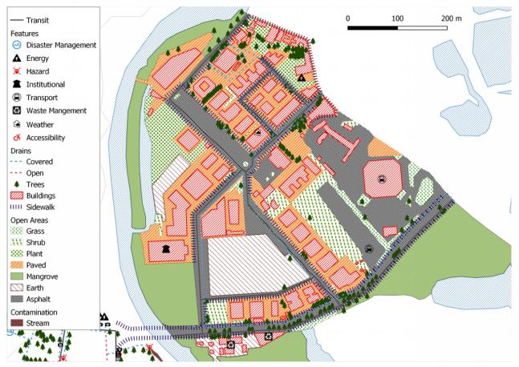

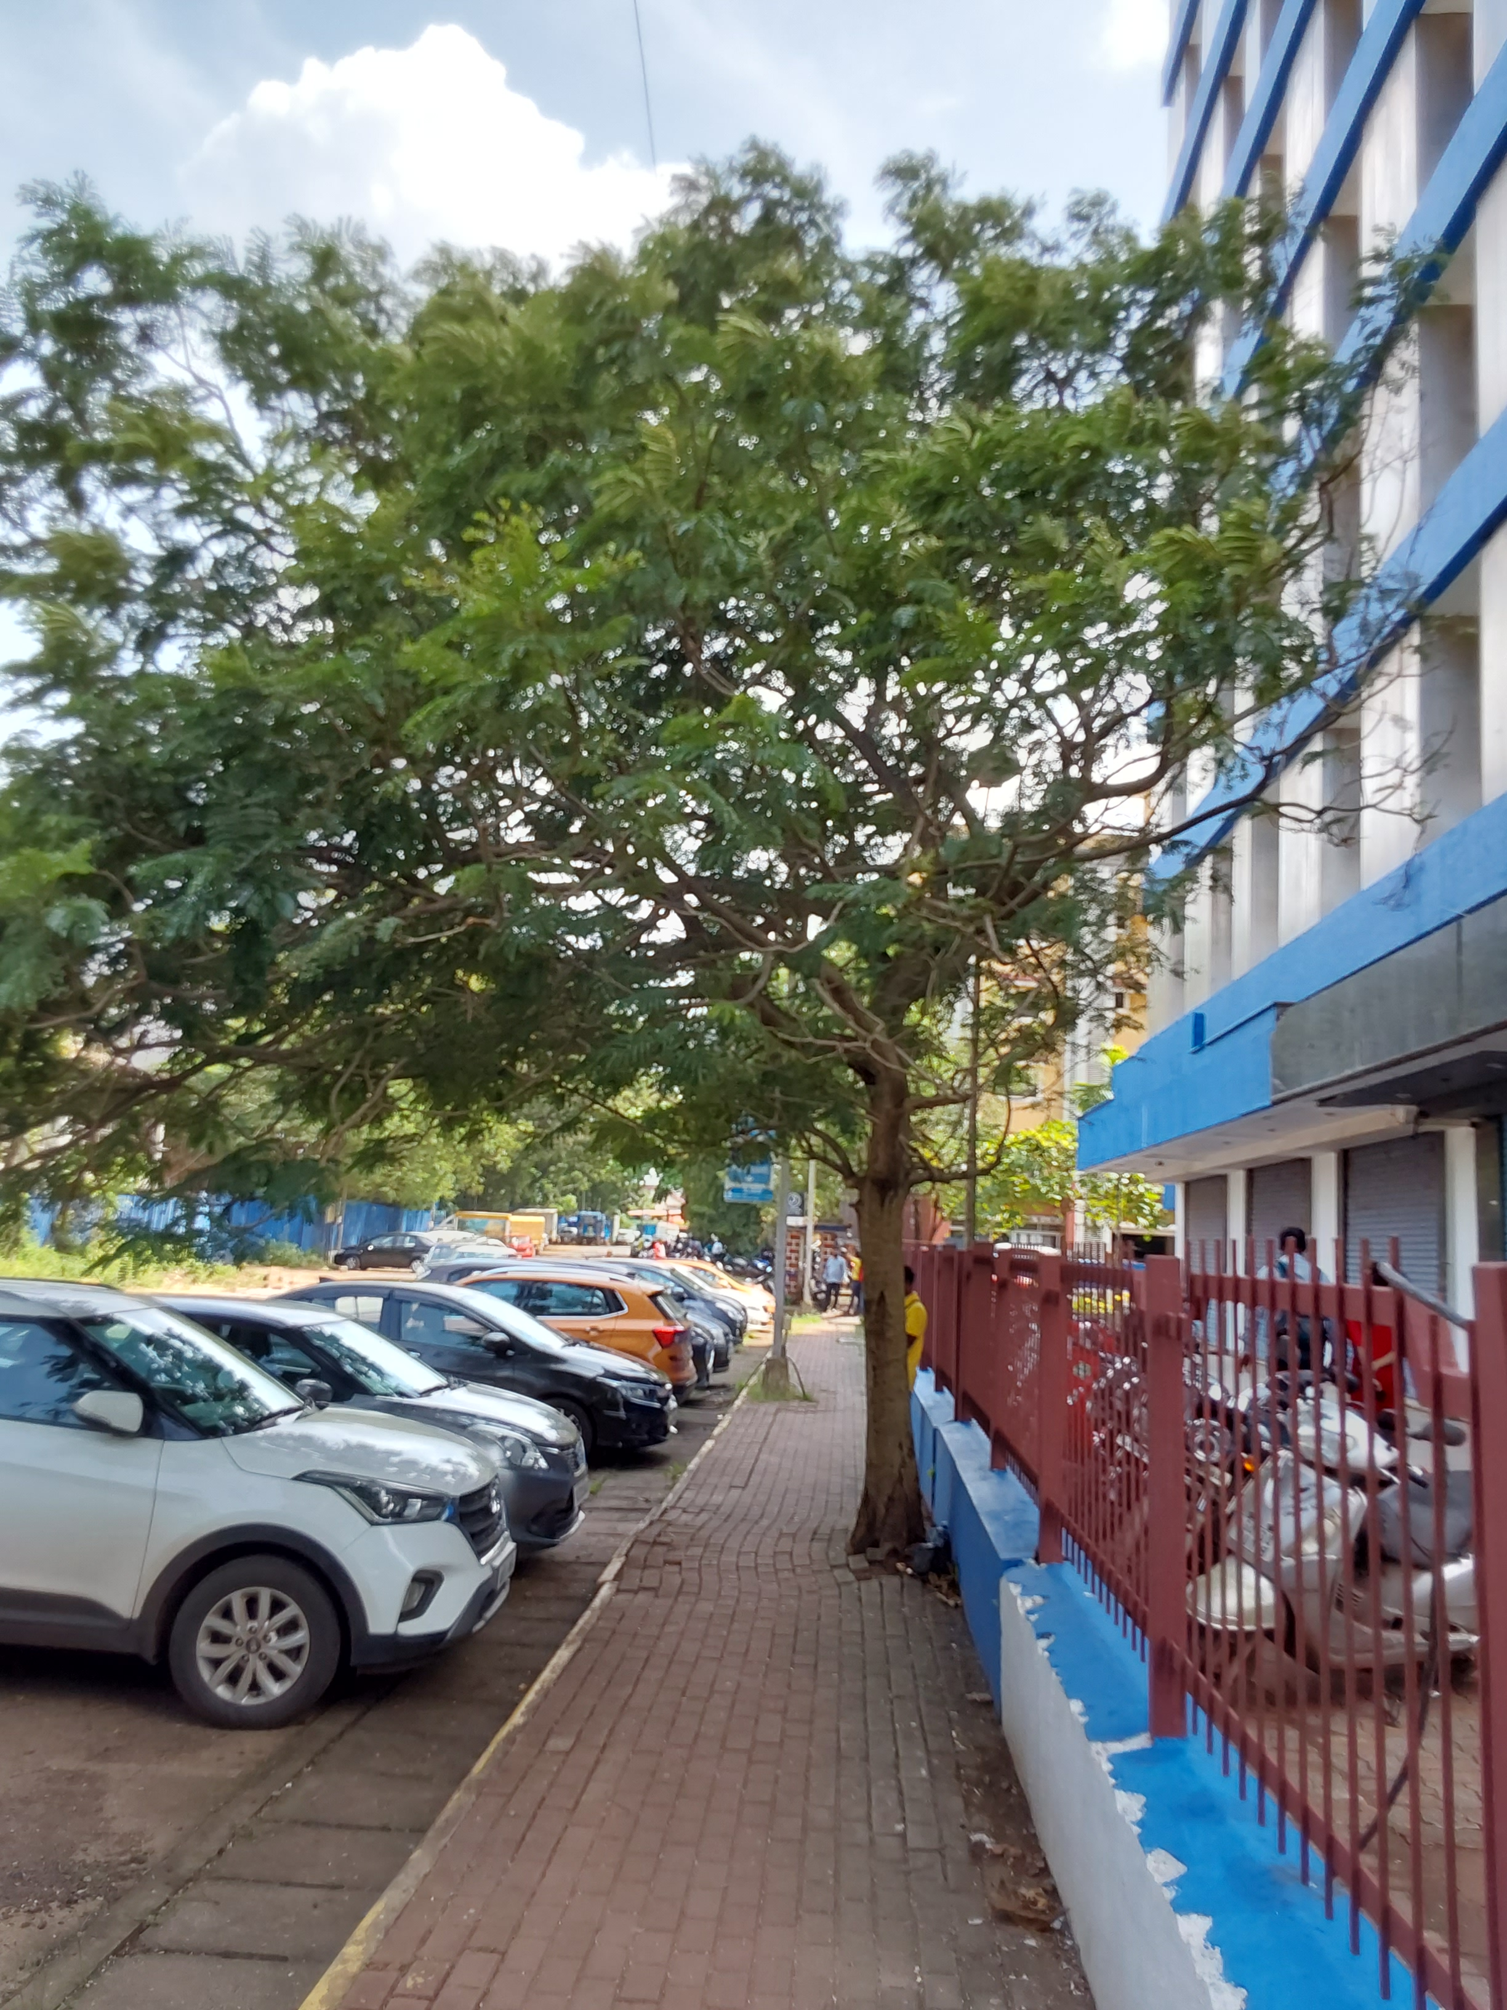

Mobility and Air Quality
3. Percentage of coverage of NMT network (pedestrian & bicycle) in the city
Non-motorized Transport & Walking
Ward 28(Patto)
M. ARCH. in SUSTAINABLE HABITAT

Slide 62
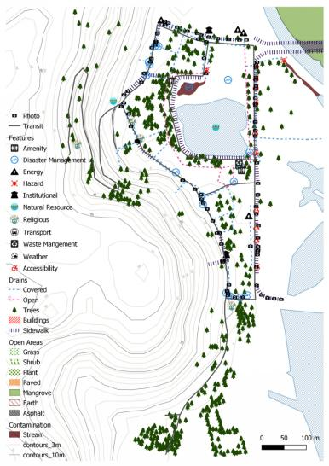
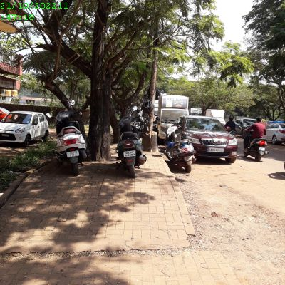
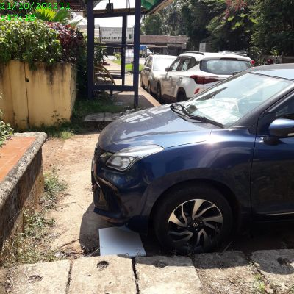
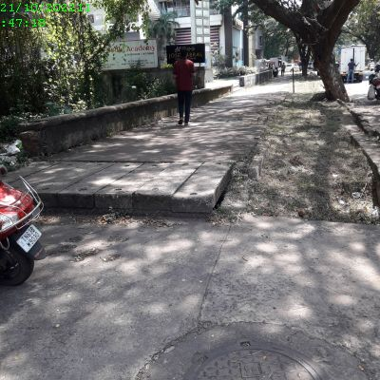

Mobility and Air Quality
3. Percentage of coverage of NMT network (pedestrian & bicycle) in the city
Non-motorized Transport & Walking
Ward 28(Patto)
M. ARCH. in SUSTAINABLE HABITAT

Slide 63
Mobility and Air Quality
3. Percentage of coverage of NMT network (pedestrian & bicycle) in the city
Indicator Analysis
Area has very high network of pedestrian walkway
There are no dedicated cycle tracks
Pedestrian walkways are interrupted & encroached at frequent locations
Well designed road crossings are absent
There is network of walkways & steps deep into settlement areas
Pedestrian walkways are not maintained to be friendly for differently abled
Possible Scenarios
Historical pathway deisgn belonging to non-motorised age
Wide planned streets in Ward28
Low density of settlement
Long urban history
City initiatives
M. ARCH. in SUSTAINABLE HABITAT

Slide 64
Mobility and Air Quality
4. Level of Air Pollution
Rationale
Climate and air pollutants including CO2 emissions have a common origin- the current energy model. Both are worsened by the burning of fuel and increase the CO2 emissions. Sound urban planning and clean technologies are now recognized as solutions to air pollution. The smart cities present a unique opportunity to adapt to advanced air quality- monitoring technologies. Cities are encouraged to adopt affordable technologies by introducing low-cost air-quality sensors and linking the latter to the Integrated Command and Control Centres. This approach can complement the Pollution Control Board’s existing monitoring system to provide further data on localised areas, hot spots and help generate real-time information for cities to take corrective action as well as gauge improvements. Air pollution data will not only help the government in framing policies and measures but allow citizens to make informed decisions that can improve the quality of their lives.
(Unit: None)
M. ARCH. in SUSTAINABLE HABITAT

Slide 65
Mobility and Air Quality
4. Level of Air Pollution
Description
A city level air-quality monitoring grid is important to generate holistic data, helps to assess the risks, implements control measures and assesses other climate smart strategies adopted by the city. The city is encouraged to assess to what extent it has achieved National Ambient Air Quality Standards (NAAQS),2009. The National Clean Air Programme sets a target of 20 -30 percent reduction of air pollution levels with 2017 as the base year. A city level air-quality monitoring grid is important to generate holistic data, helps to assess the risks, implements control measures and assesses other climate smart strategies adopted by the city.
Methodology
The indicator assesses the existing city level air quality monitoring mechanism, its strengthening requirements and availability of air quality data on public domain. City will be assessed on its additional pollutants monitoring, its reduction strategies, its implementation and compliance to the National Standards.
Formula
According to National Ambient Air Quality Standard by CPCB.
M. ARCH. in SUSTAINABLE HABITAT

Slide 66
Mobility and Air Quality
4. Level of Air Pollution
Evaluation Score Levels
0
25
50
75
100
Level 5
Level 4
Level 3
Level 2
Level 1
M. ARCH. in SUSTAINABLE HABITAT
Achievement of
National Air Quality Standards
Air Pollution
Reduction Trend
Availability of
Data in Public
Domain
Basic Monitoring
No Consideration

Slide 67
Mobility and Air Quality
4. Level of Air Pollution
Evidence Requirements | Data Evidence Available
Evidence 1 - Capture levels of PM10, PM2.5, NO x, SO x (as per CPCB Guidelines)
Evidence 2 - Additional pollutants monitored like CO, NH3, Pb and O3 etc. as per NAAQS
Evidence 3 - Daily AQI levels are published and available to public through display boards/ SAFAR/ Sameer App/ any other app
Evidence 4 - Reduction Air Pollution level based on previous year reading
Evidence 5 - Reduction trend / incremental improvement in compliance to National Clean Air Programme,
Evidence 6 - NCAP target (i.e. 20%–30% reduction of PM2.5 and PM10 concentration by 2024 keeping 2017 as the base year for the comparison of concentration. )
M. ARCH. in SUSTAINABLE HABITAT

Slide 68
Mobility and Air Quality
4. Level of Air Pollution
Calculation
Result
Monitoring of level of PM10, PM2.5, NO x, SO x, CO, NH3, Pb and O3 & daily AQI levels are published on various apps.
Current Progression Level : 3
Score | 50
Evidences 1, 2 & 3 are available.
M. ARCH. in SUSTAINABLE HABITAT
Evidences 1,2,3
Available
1
2
3
4
5
0 Evidence
Evidences 1,2
Evidences 1,2.3.4
Evidences 1,2.3.4.5

Slide 69
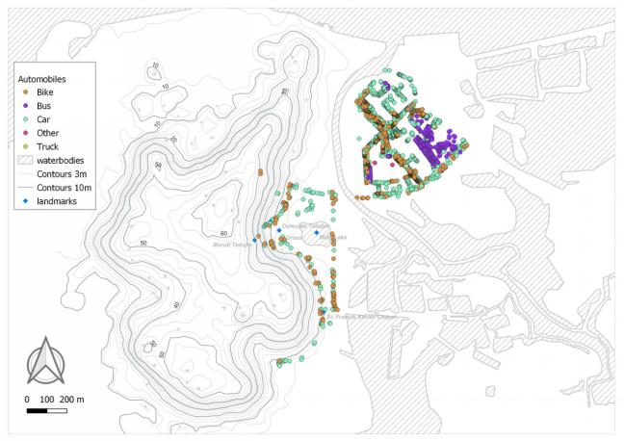
Mobility and Air Quality
4. Level of Air Pollution
Vehicle presence at a given point of time
M. ARCH. in SUSTAINABLE HABITAT
1095 Cars, 196 Buses, 667 Bikes

Slide 70
Mobility and Air Quality
4. Level of Air Pollution
Indicator Analysis
There is regular monitoring of air pollutants
Monthly compiled data is published online
There is no evidence of improvement in Air Quality Index
There is no Departmental App to publish AQI
There is only one monitoring station in towns like Panaji, Margao
Air Quality is getting worse in Panjim showing no improvement
Possible Scenarios
Lack of tree cover at Patto where the monitoring station is located
Large movement of vehicles & presence of transport depot
Large land area under cement pavement
Ineffiecient HVAC services
Untreated waste water flowing into nearby open areas
M. ARCH. in SUSTAINABLE HABITAT

Slide 71
Mobility and Air Quality
5. Clean Air Action Plan (Planning and Implementation)
Rationale
Unsustainable urban planning, lack of proper waste management, poor technology in industries and increased urban transport have all led to rise in air pollution in cities in India. According to the Health Organisation (WHO), seven million people die prematurely from health risks every year owing to air pollution. The Smart city Mission sets out to bring in its fold the urban policy design of public transit oriented urban mobility, smart parking, intelligent traffic management and integrated multi-modal transport, prioritising non-motorised transport, digitalisation of public services, and waste management e.g. reduction of C&D (construction and demolition) waste, all of which are good practices for better air quality. These are also actions that need to be emulated in the entire city.
(Unit: None)
M. ARCH. in SUSTAINABLE HABITAT

Slide 72
Mobility and Air Quality
5. Clean Air Action Plan (Planning and Implementation)
Description
Cities should take onus for providing healthy air quality to the citizens. Clean Air Action Plans mandated by the National Clean Air Programme (2019) of Government of India integrate the cumulative city level actions for better air quality. For a city to be climate smart it should be able to address the issues of reducing air and climate pollutants since both air and climate pollutants arise from similar sources and addressing one has a direct co benefit to the other. Clean Air is integral for achieving climate smartness by a city.
Methodology
Indicator assesses to what extent the city has made efforts to improve the air quality, through clean air action planning and proper air quality management strategy in cities. To generate data and identify sources through scientific methods and subsequently to develop and implement sectoral strategies and projects that are components of the clean air action plan. This has to be done in close co-ordination with the State Level monitoring authorities and other stakeholder departments. The clean air action plan needs to be reviewed and monitored to assess improvements in air quality.
M. ARCH. in SUSTAINABLE HABITAT

Slide 73
Mobility and Air Quality
4. Level of Air Pollution
Evaluation Score Levels
0
25
50
75
100
Level 5
Level 4
Level 3
Level 2
Level 1
M. ARCH. in SUSTAINABLE HABITAT
Assessing
impacts of Clean
Air Action Plan
implementation
Implementation of Clean Air Action Plan
Clean Air Action Plan and Pollutants Source
Identification
Air Pollutant
Monitoring
No Air Pollutant
Monitoring Clean Air Action Plan in the city

Slide 74
Mobility and Air Quality
5. Clean Air Action Plan (Planning and Implementation)
Evidence Requirements
Evidence 1 - Monitoring Stations for measuring Ambient Air Quality (please indicate number of stations, differentiate between manual stations /continuous ambient air quality monitoring stations (CAAQMS) / continuous emission monitoring system (CEMS)
Evidence 2 - Air Quality Monitoring mechanism linked with ICCC/ Sensors based monitoring systems
Evidence 3 - Map of monitoring stations in the city as .kml files (point or polygon geometry)
Evidence 4 - Map of air pollution sensors in the city as .kml files (point geometry)
Evidence 5 - Clean Air Action Plan prepared by SPCB based on CPCB guidelines as per National Clean Air Programme, (NCAP) developed
Evidence 6 - Any other Clean Air Action Plan developed by Municipal Authority / Smart City Mission in case of other cities
Evidence 7 - Scientific study based on CPCB / SPCB led Source Apportionment Studies and Emissions Inventories
Evidence 8 - Any other available government validated studies for identifying source/EIs
Evidence 9 - Implementation of at least 2 measures under the domain of the ULB as specified in Clean Air Action Plan
Evidence 10 - Impact assessment for implementation of Clean Air Action Plan measures with evidence of improvements in air quality
M. ARCH. in SUSTAINABLE HABITAT

Slide 75
Mobility and Air Quality
5. Clean Air Action Plan (Planning and Implementation)
Data Evidence Available
Evidence 1 - Monitoring Stations for measuring Ambient Air Quality, total 18 stations in Goa, 1 in Panaji at Patto
Evidence 2 - Air Quality Monitoring mechanism linked with ICCC/ Sensors based monitoring systems
Evidence 3 - Map of monitoring stations available on the website
Evidence 4 - Map of air pollution sensors in the city prepared
Evidence 5 - Clean Air Action Plan prepared by SPCB based on CPCB guidelines as per National Clean Air Programme, (NCAP) developed Source: Goa Water Air Rules 2021
Evidence 6 - Any other Clean Air Action Plan developed by Municipal Authority / Smart City Mission in case of other cities
Evidence 7 - Scientific study to compare Air Quality between that of pre-pendemic and during pendemic months Source:GSPCB
Evidence 8 - Any other available government validated studies for identifying source/EIs
M. ARCH. in SUSTAINABLE HABITAT

Slide 76
Mobility and Air Quality
5. Clean Air Action Plan (Planning and Implementation)
Calculation
Result
Monitoring of level of air pollution is conducted regularly in the area with one monitoring station, and sensor newtwork, Goa Air & Water Rules 2021 is notified.
Current Progression Level : 3
Score | 50
Evidences 1, 2, 3, 4, 5, 6, 7, 8 are available.
M. ARCH. in SUSTAINABLE HABITAT
Evidences 1,2,3,4,5,6,7,8
Available
1
2
3
4
5
0 Evidence
Evidences 1,2,3,4
Evidences 1,2.3.4,5,6,7,8,9
All 10 Evidences

Slide 77
Mobility and Air Quality
5. Clean Air Action Plan (Planning and Implementation)
Indicator Analysis
There is one air quality monitoring station in the area
Draft legislation to improve air quality is notified
There is lack of plan in place to identify source of pollution
Studies have not reaached the conclusion to identify the source of pollutants
There is no significant improvement in Air Quality Index
Not reached beyond implemntation of monitoring to enter domain of improvement of AQI
Possible Scenarios
City is not monitoring the AQI instead it is limted to GPCB
Legislation has come into force recently
There are no monitoring stations in other parts pf the city to compare data
GPCB is located away from the city
Studies are limited coming from government intitutions only
M. ARCH. in SUSTAINABLE HABITAT

Slide 78
MOBILITY & AIR QUALITY
Mobility and Air Quality
1. Clean Technologies Shared Vehicles
2. Availability of Public Transport
3. Percentage of coverage of NMT network (pedestrian & bicycle) in the city
4. Level of Air Pollution
5. Clean Air Action Plan (Planning and Implementation)
25/100
100/100
100/100
50/100
50/100
1
5
M. ARCH. in SUSTAINABLE HABITAT
2
4
3
TOTAL SCORE = 325 / 500

Slide 79

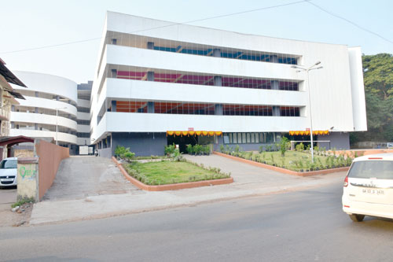
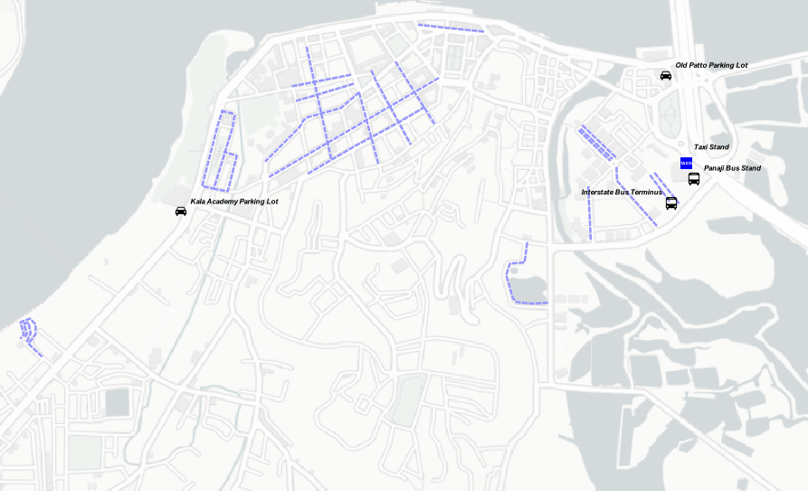
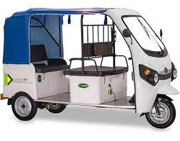
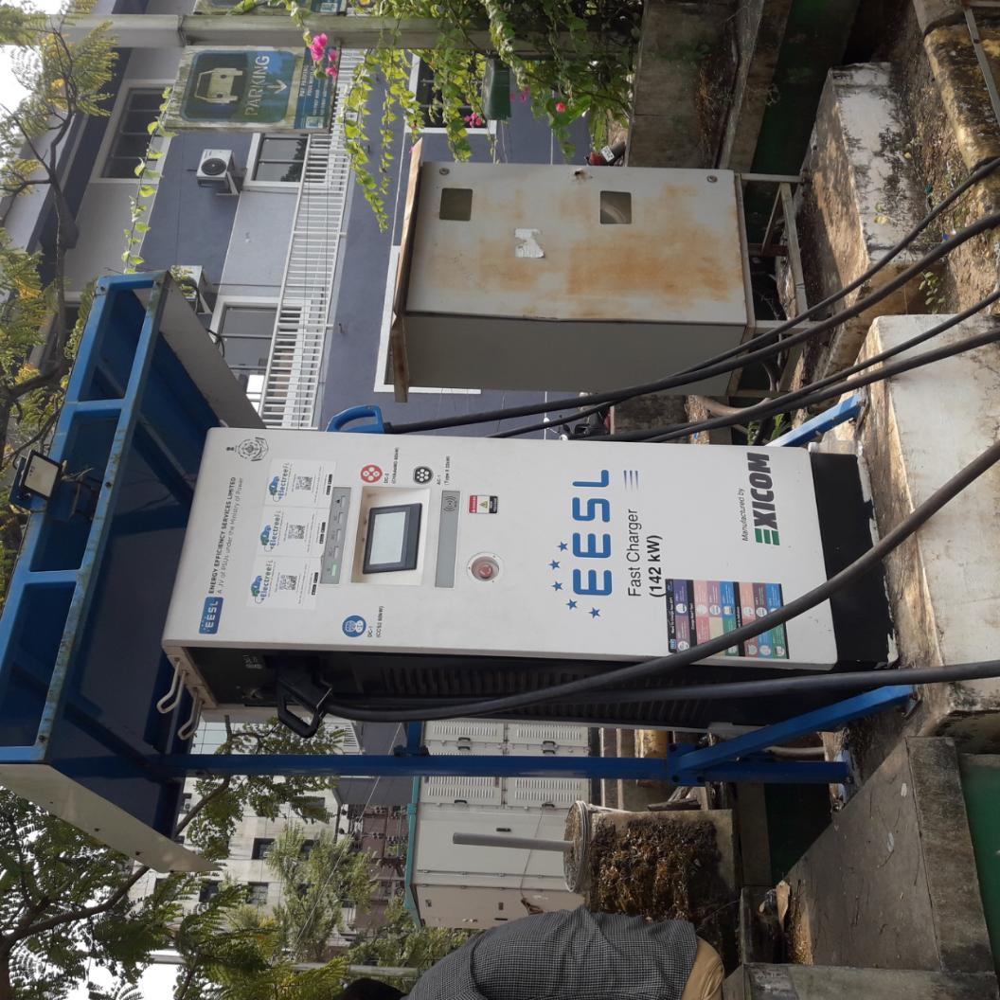




Cruise Jetty
Multilevel Parking 465 Cars
RE- Powered Mobility Plan
EXISTING INFRASTRUCTURE
M. ARCH. in SUSTAINABLE HABITAT
Courtesy TOI, Goa.

Slide 80






Bike UI Guided Heritage Route
FOR TOURISTS
Cruise Jetty
Multilevel Parking 465 Cars
EV
Chargers
2. ELECTRIC ONLY
INNER CITY
1. ICE RING ROAD
M. ARCH. in SUSTAINABLE HABITAT
FOR REGULAR COMMUTERS
Bike Station
FOR
ELDERLY
State & inter-state
Bus stand
e Para
Transport

Slide 81





BATTERY BANK &
TRANSFORMERS
WARD 28(PATTO)
ODP 2021, PANAJI.
BIKE STATION
PV FARM
M. ARCH. in SUSTAINABLE HABITAT
CONTROL ROOM
PV ROOF PARKING AND CHARGER
WORKSHOP
& STAFF
QUARTERS

Slide 82

WARD 19 & 20,
ODP 2021, PANAJI.
PV FARM
M. ARCH. in SUSTAINABLE HABITAT
BATTERY BANK, ELECTRICAL CONTROL
PV ROOF PARKING AND CHARGERS

Slide 83




EXISTING
1’
2’
1
2
NEW
NTS
SECTION 11’
M. ARCH. in SUSTAINABLE HABITAT
8M X 1M X 2.5M MODULE
NTS
SECTION 22’

Slide 84
Solar Energy Requirements & Estimates
Total electricity demand in the area is 3,66,117,60 KWHr
Area under PV Panels required to meet the demand is 1,21,070 sq.m.
Area Available (in sq.m.)
Existing Roofs |  | Upcoming Roofs |  |  | Poposed Parking |  |  | Southern Facades
45000 |  | 17000 |  |  | 13000 |  |  | 10000
Total |  |  |  |  | 85,000 sq.m.
Possible power output from the area |  |  |  |  | 2,57,04,000 KWHr
Current Power demand for shift to EV(in KWHr)
EV Equivalent | Charging Time |  | Charger Cap. | Tot. Pow(kwhr) |  | No. of Vehicles | Time Period |  | Tot. Power need
500W Ather bike | 5 |  | 3.7 | 18.5 |  | 667 | 1 year |  | 4507002.4
Tata Nexon EV | 4 |  | 7.2 | 28.5 |  | 1095 | 1 year |  | 11518524.0
Total (KWHr) |  |  |  |  |  |  |  |  | 1,60,25,526
Surplus (KWHr) |  |  |  |  |  |  |  |  | 96,78,473
M. ARCH. in SUSTAINABLE HABITAT

Slide 85

Phase I
M. ARCH. in SUSTAINABLE HABITAT

Slide 86




Phase II
M. ARCH. in SUSTAINABLE HABITAT

Slide 87




Phase III
TYPICAL SECTION (NTS)
M. ARCH. in SUSTAINABLE HABITAT
State of Goa
Underground MRT

Slide 88




M. ARCH. in SUSTAINABLE HABITAT

Slide 89

M. ARCH. in SUSTAINABLE HABITAT

Slide 90

SCAN WITH GOOGLE LENS OR ANY OTHER QR SCANNER APP FOR MORE RESOURCES
M. ARCH. in SUSTAINABLE HABITAT
THANK YOU!

